Slide 1

DEPARTMENT OF COMPUTER SCIENCE & ENGINEERING
SCHOOL OF COMPUTING
1156CS701- MAJOR PROJECT
INTERNSHIP THROUGH DIND/PLACEMENT/ABROAD
WINTER SEMESTER(22-23)
REVIEW - I
LOCATION-BASED CRIME TYPE PREDICTION
SUPERVISED BY
Faculty Name
Designation
PRESENTED BY
1. Student name (VTU.NO)(REG.NO)
2. Student name (VTU.NO)(REG.NO)
3. Student name (VTU.NO)(REG.NO)

Slide 2
AGENDA
ABSTRACT
OBJECTIVE
INTRODUCTION
LITERATURE REVIEW
DESIGN AND METHODOLOGIES
IMPLEMENTATION
CONCLUSION
OFFER LETTER SOFT COPY/SCANNED COPY
INDUSTRY DETAILS
REFERENCES

Slide 3
ABSTRACT
Finding both spatial and temporal criminal hotspots is the primary emphasis of this work.
It examines several datasets based on crimes that have occurred in the actual world. After that, it elucidates how we implemented an algorithm in order to develop intriguing common patterns for crime hotspots.
In addition, the research demonstrates how we utilized logistic regression to make predictions for possible sorts of criminal activity.
This research presents an analytical study that combines our findings of crimes' dataset with its demographics information in order to capture the aspects that can affect the safety of neighborhoods.
The purpose of this study is to further analyze crimes' datasets, and it is introduced in the paper.
The results of implementing this method might be utilized to increase people's awareness of the dangerous regions and to assist agencies in predicting future crimes in a certain location within a specific time frame. Both outcomes would be beneficial.

Slide 4
OBJECTIVES
Aim of the Project:
The main objective of the project is to find spatial and temporal criminal hotspots using a set of real-world datasets of crimes. Based on this Information the officials can take charge and try to reduce the crime rate. The goal of this challenge is to apply machine learning procedures to find a criminal sample with the aid of its category with the given precise time and location. The major aim of this mission is to expect which category of crime is most probably to take place at a detailed time and places. Crime analysis based on available information to extract crime patterns.
Scope of the Project:
Our approach will help regulation enforcement agencies to have assumption ahead about the possibility of crime, which could arise at a place in a given time. This will assist them to resolve the instances faster than earlier. In addition, having this kind of knowledge would help people to improve their living place choices. On the other hand, police forces can use this solution to increase the level of crime prediction and prevention. The advantages of crime prediction techniques are they help us visualize criminal network, reduce the risk, increase crime analysts work productivity.

Slide 5
INTRODUCTION
Crime reduction is becoming one of the most important social issues in enormous metropolitan areas because it influences people's concerns about their personal safety, the development of children, and individuals' socioeconomic standing. This is due to the fact that larger cities have higher crime rates than smaller cities. The crime rate forecasting method is a method that determines the crime rate by using a variety of algorithms and basing their findings on previous information. Because of the nature of our work, we are required to travel to a large number of locations on a daily basis. Google Maps may provide us one, two, or even more routes to reach our destination; nonetheless, we almost always take the shortest route, even though this indicates that we do not fully understand the path condition. This research introduces the creation and implementation of a plan based on historical crime data and evaluates the crime rate in previous places at separate moments. Because of the uncertainty over whether or not it is actually secure, we are forced to deal with a number of unfavorable scenarios. Using a collection of information taken from the real world, the purpose of this research is to identify both temporal and spatial hotspots for criminal activity. We are going to make an effort to identify the places and times of the crimes that are most likely to occur there. In addition to this, we will speculate on the kind of the offence that may be committed in the future at a given area and at a particular time. In conclusion, one of our goals is to conduct an analysis study, which will be accomplished by merging the findings that we obtained from a specific crimes dataset with the demographics information that it contains.

Slide 6
LITERATURE REVIEW
[1] N Kanimozhi, N V Keerthana, G S Pavithra, G Ranjitha, S Yuvarani, “CRIME Type and Occurrence Prediction Using Machine Learning Algorithm”, International Conference on Artificial Intelligence and Smart Systems (ICAIS), 2021
In this study, N Kanimozhi implements such a crime pattern analysis by utilizing crime data obtained from the Kaggle open source, which is then used to predict the most recently occurring crimes. Some machine learning algorithms, such as Nave Bayes, are used in this work to classify various crime patterns, and the accuracy achieved is comparable to pre-composed works.
[2] Wajiha Safat, Sohail Asghar, Saira Andleeb Gillani, “Empirical Analysis for Crime Prediction and Forecasting Using Machine Learning and Deep Learning Techniques”, IEEE Access ( Volume: 9), 2021
To better fit the crime data, Wajiha Safat used a variety of machine learning algorithms, including logistic regression, support vector machine (SVM), Nave Bayes, k-nearest neighbors (KNN), decision tree, multilayer perceptron (MLP), random forest, and eXtreme Gradient Boosting (XGBoost), as well as time series analysis using long-short term memory (LSTM) and autoregressive integrated moving average (ARIMA).

Slide 7
LITERATURE REVIEW
[3] B. Sivanagaleela, S. Rajesh, “Crime Analysis and Prediction Using Fuzzy C-Means Algorithm”, 3rd International Conference on Trends in Electronics and Informatics (ICOEI), 2019
This system is primarily concerned with determining where the crime will occur rather than identifying the criminal. The existing system employed naive bayes classification. The fuzzy C-Means algorithm will be used in the current system to cluster crime data for total cognizable crimes such as murder, theft, cheating, kidnapping, crime against women, robbery, and other such crimes.
[4] Myung-Sun Baek, Wonjoo Park, Jaehong Park, Kwang-Ho Jang, Yong-Tae Lee, “Smart Policing Technique With Crime Type and Risk Score Prediction Based on Machine Learning for Early Awareness of Risk Situation”, IEEE Access ( Volume: 9), 2021
Myung-Sun Baek designs and validates a crime type and associated risk prediction technique based on machine learning technology. The KICS data format is used for text-based criminal case summary data, which is actual policing data containing information about criminal cases. For the crime type, the system considers 21 representative types of crimes; thus, the system can predict one of the 21 types of criminal activity for each criminal case.

Slide 8
LITERATURE REVIEW
[5] Sai Tarlekar, Rucha Bhosle, Elysia D'souza, Sana Sheikh, “Geographical Crime Rate Prediction System”, IEEE India Council International Subsections Conference (INDISCON), 2021
Crime analysis and prediction is a systematic method for categorizing the kinds of crimes committed, the purpose of the crime, and forecasting future crimes. The dataset includes official police statements as well as data scraped from trustworthy websites. The system can calculate hotspot areas by analyzing crime reports. Crime data analysts can assist law enforcement officers in locating criminals more quickly. The goal of this proposed system is to investigate datasets and analyze crimes that have been committed, and then predict crimes using the Random Forest Algorithm.

Slide 9
DESIGN AND METHOLOGIES
MODULE 1: Data Acquisition and Pre-Processing
We will be using a csv dataset with 18 columns and 2100 rows from Kaggle on crime prediction. Data preprocessing changes the data into a format that can be processed in machine learning, and other data science tasks more quickly and efficiently.
MODULE 2: Making The Model
The algorithms used for our model are binary classification with logistic regression. Logistic regression is used in the classifier construction process. Compared to linear regression, logistic regression is more sophisticated.
MODULE 3: Making A Prediction Function and Creating A Web App
The last stage is to develop a prediction function that will accept input as location and time and determine the crimes that can take place in the given area at the given time.

Slide 10
MODULE 1: Data Acquisition and Pre-Processing
Step 1: Data Acquisition
We collected a csv dataset with 18 columns and 2100 rows from Kaggle on crime prediction.
Step 2: Data Pre-Processing
We have chosen to concentrate on the following measures for our dataset:
Making The Dataset A Time-Series Dataset
Eliminating Null Elements
Finding out Correlation
Extracting Important Features
Step 3: Splitting The Dataset Into Training and Testing
To divide our dataset into train and test, the pandas and sklearn packages are imported.
Step 4: Data Normalization
Data is normalized to put all of the attributes on the same scale.
Step 5: Convert The Data into Tensor
The TensorFlow library's tf.convert_to_tensor() method is used to convert a NumPy array into a Tensor.

Slide 11
MODULE 2: Making The Model
Step 1: Making The Model
The algorithms used for our model are binary classification with logistic regression.
In our model, the data's street addresses were mapped, and the coordinates of each incident were determined by creating a grid reference system. An epicenter can be determined based on the concentration of events within each grid by annotating the number of events per grid.
Step 2: Defining the Optimizer And Loss Function
Loss function and optimizer are two most deciding factors for a model being a great model or an ill-trained model, we have used Mean Square Error Loss as Loss function and Adam as optimizer.
A larger MSE indicates that the data points are widely dispersed around the central moment (mean), whereas a smaller MSE indicates the opposite. A lower MSE is preferable because it indicates that your data points are clustered closely around its central point (mean). It reflects your data's centralized distribution, the fact that it is not skewed, and, most importantly, it has fewer errors.

Slide 12
MODULE 3: Making A Prediction Function and Creating A Web App
Step 1: Making A Prediction Function
On the basis of the trained model, we may predict the labels of the data values using the Python predict() method.
The data to be tested is typically the sole argument that the predict() function accepts. Based on the learnt or trained data generated from the model, it returns the labels of the data supplied as an argument.
As a result, the predict() function uses the learnt label to map and predict the labels for the test data on top of the trained model.
Step 2: Creating UI Using Streamlit
An open-source Python framework called Streamlit is used to create web applications for machine learning and data science. Using Streamlit, we can quickly design and launch web applications.
Working on the interactive cycle of coding and watching outcomes on the web app is made simple by Streamlit. We use Streamlit to create apps using Python code.

Slide 13
IMPLEMENTATION
In the proposed system is done using real-time datasets and also we are leveraging various factors like location, time, date and rate of crimes percentage as well.
The proposed system leverages a multi-modal machine learning approach. It proves to be more accurate due to the use of multiple classifiers for class prediction.
The proposed model works well against train data and test data further this model will provide better results for real-time data.
A comparative analysis of the proposed model with state-of-the-art methods assessed that our model was able to outperform the other models in terms of efficiency, accuracy, and processing time.
It is a fast, cost-efficient, quick, and highly accurate method to identify patterns

Slide 14
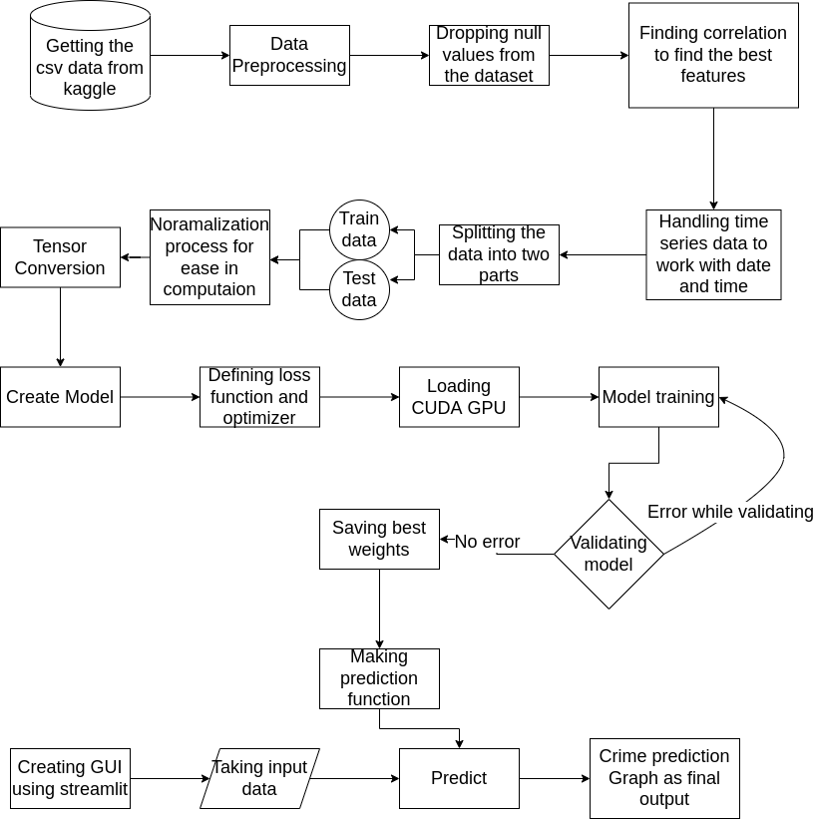
ARCHITECTURE DIAGRAM

Slide 15
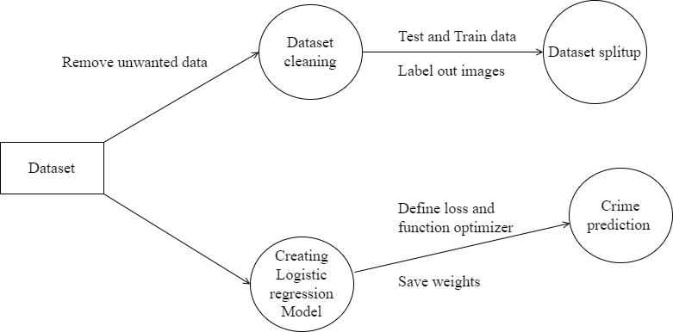
DATA FLOW DIAGRAM
Level DFDs represent the complete system as a single process. it notates every process and sub-process that comes together in a sequence to form the complete system.

Slide 16
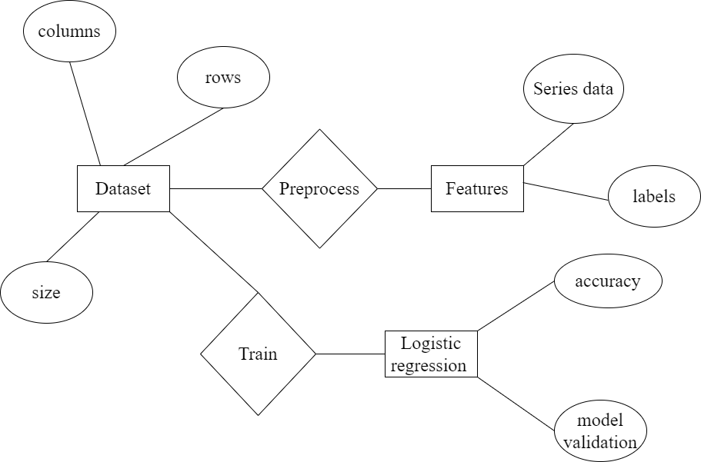
ER- DIAGRAM
ER or entity relationship diagram helps to analyze data. It has three basic things-entities, attributes, and relationships. They are important to understand the structure and working of any model.

Slide 17
CONCLUSION
In addition to the current focus of our study, which is the forecasting of the crime that a specific offender is most likely to do, we are able to forecast, as a future focus, the approximate amount of time that the offender will spend committing the crime. In addition to this, one can make an educated guess as to the location of the criminal activity. We are going to determine how accurate frequently occurring item sets and prediction based on various test sets are. Therefore, the system will automatically learn the shifting patterns in criminal behavior by inspecting the patterns of criminal behavior. Additionally, the elements that contribute to crime shift throughout time. By reorganizing the data on crime, we need to locate new factors that are contributors to criminal behavior. Given that we are only taking into account a select few parameters, it is impossible to reach complete accuracy. We need to identify more criminal attributes so that we can get more accurate outcomes from our predictions. Our software is able to forecast the type of criminal act that will be committed by a specific offender.

Slide 18
OFFER LETTER SOFT COPY/SCANNED COPY
Include here.

Slide 19
INDUSTRY DETAILS
Industry Guide Name :
Industry Mobile Number :
Industry Guide Mail ID :
Industry Address : (Mention completed Address)
Time line/Duration given by Industry for completion of Project : 4 Months(Eg. Jan 23-Apr 23)
Date of Reporting to Industry

Slide 20
REFERENCES
[1] Pavan Kumar K. N., Marina L. Gavrilova, “Latent Personality Traits Assessment From Social Network Activity Using Contextual Language Embedding”, Transactions on Computational Social Systems ( Volume: 9, Issue: 2, April 2022), 2021
[2] Wajiha Safat, Sohail Asghar, Saira Andleeb Gillani, “Empirical Analysis for Crime Prediction and Forecasting Using Machine Learning and Deep Learning Techniques”, IEEE Access ( Volume: 9), 2021
[3] B. Sivanagaleela, S. Rajesh, “Crime Analysis and Prediction Using Fuzzy C-Means Algorithm”, 3rd International Conference on Trends in Electronics and Informatics (ICOEI), 2019
[4] Myung-Sun Baek, Wonjoo Park, Jaehong Park, Kwang-Ho Jang, Yong-Tae Lee, “Smart Policing Technique With Crime Type and Risk Score Prediction Based on Machine Learning for Early Awareness of Risk Situation”, IEEE Access ( Volume: 9), 2021
[5] Sai Tarlekar, Rucha Bhosle, Elysia D'souza, Sana Sheikh, “Geographical Crime Rate Prediction System”, IEEE India Council International Subsections Conference (INDISCON), 2021

Slide 21
REFERENCES
[6] Lavanya Elluri, Varun Mandalapu, Nirmalya Roy, “Developing Machine Learning Based Predictive Models for Smart Policing”, IEEE International Conference on Smart Computing (SMARTCOMP), 2019
[7] Saroj Kumar Dash, Ilya Safro, Ravisutha Sakrepatna Srinivasamurthy, “Spatio-temporal prediction of crimes using network analytic approach”, IEEE International Conference on Big Data (Big Data), 2019
[8] Suhong Kim, Param Joshi, Parminder Singh Kalsi, Pooya Taheri, “Crime Analysis Through Machine Learning”, IEEE 9th Annual Information Technology, Electronics and Mobile Communication Conference (IEMCON), 2019
[9] Charlie Catlett, Eugenio Cesario, Domenico Talia, Andrea Vinci, “A Data-Driven Approach for Spatio-Temporal Crime Predictions in Smart Cities”, IEEE International Conference on Smart Computing (SMARTCOMP), 2018
[10] Nelson Baloian, Col. Enrique Bassaletti, Mario Fernández, Oscar Figueroa, Pablo Fuentes, Raúl Manasevich, Marcos Orchard, Sergio Peñafiel, José A. Pino, Mario Vergara, “Crime prediction using patterns and context”, IEEE 21st International Conference on Computer Supported Cooperative Work in Design (CSCWD), 2017

Slide 22
THANK YOU

